Slide 1
National Chicken Council – October 2016
Pork Industry Situation & Outlook

Slide 2
Key issues for the hog market . . .
Demand – lower than 2015 but still solid
Exports – Growing vs. ‘15 but nothing like what was expected by LH futures in spring
Hog numbers – Up in July, as expected in August and a HUGE September – FALL???
Weights – sending conflicting information about currentness of marketings.
Competitive meat supplies are growing – and retail prices (esp. beef) will decline

Slide 3
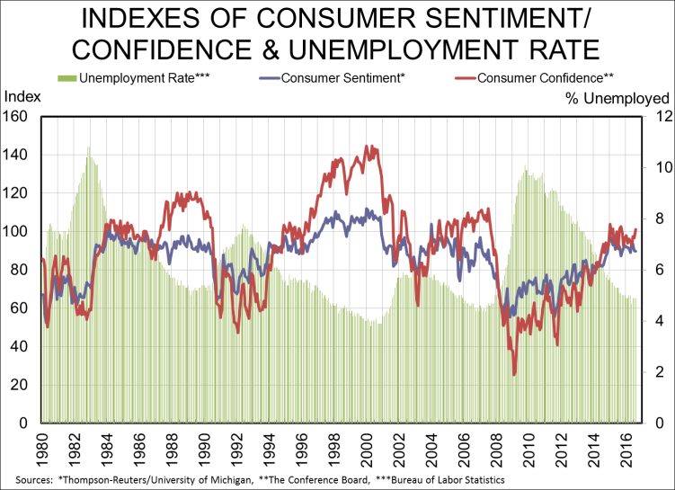
Consumer attitudes continue flat pattern . . .
. . . But remain relatively strong vs. history

Slide 4
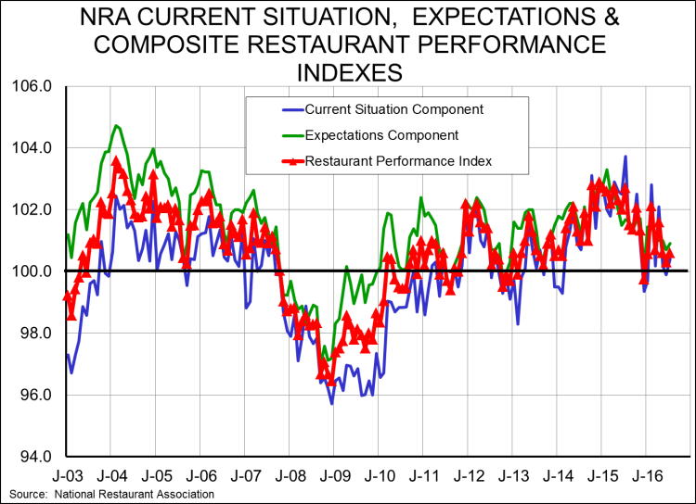
RPI was 0.3 pts higher in July, still above 100 . . .
. . . Denoting expansion in 41 of past 43 months

Slide 5
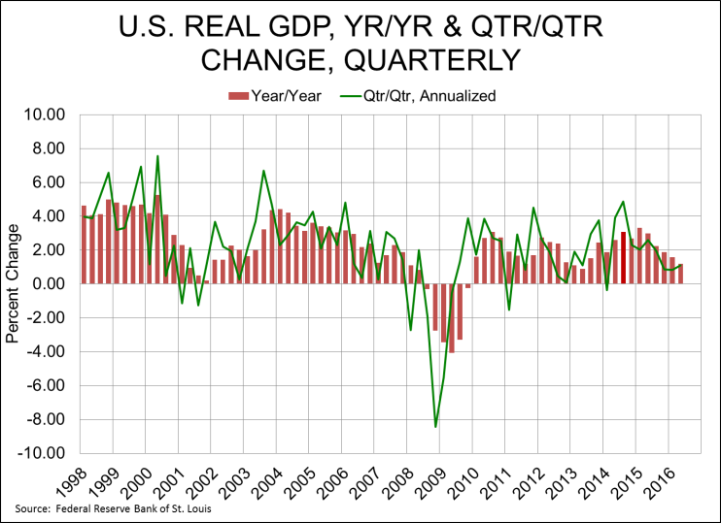
The economic recovery is more anemic this year
. . . But no recession through mid 2017 (RDLB)

Slide 6
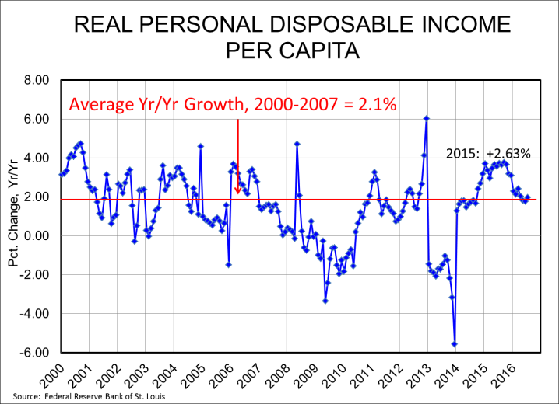
Personal dispoable income growth remains good

Slide 7
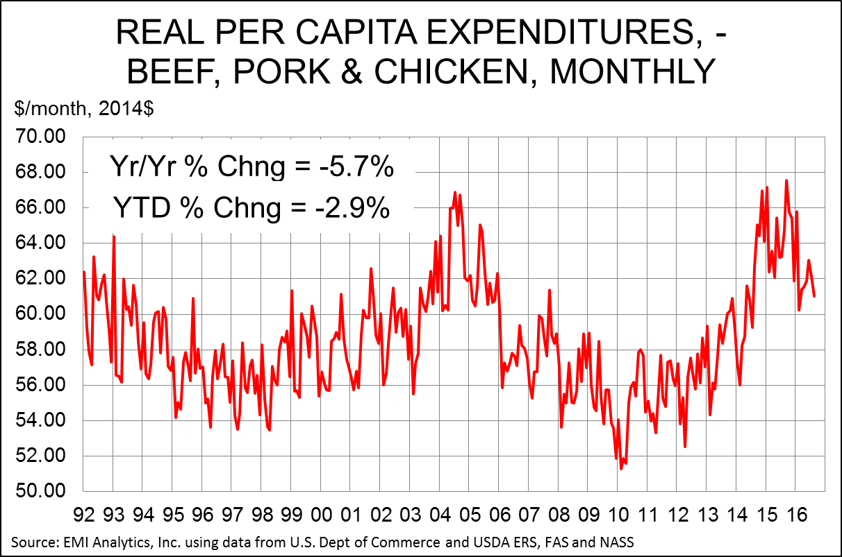
DEMAND – 3-species still lower for the year . . .
. . . But this is compared to a very strong 2015

Slide 8
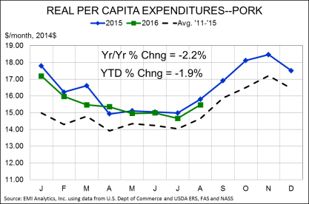
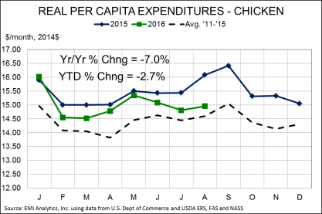
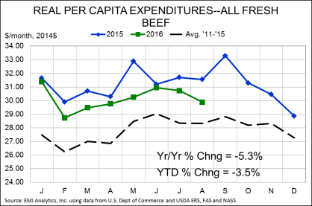
Pork was down less than beef, chicken in Aug

Slide 9
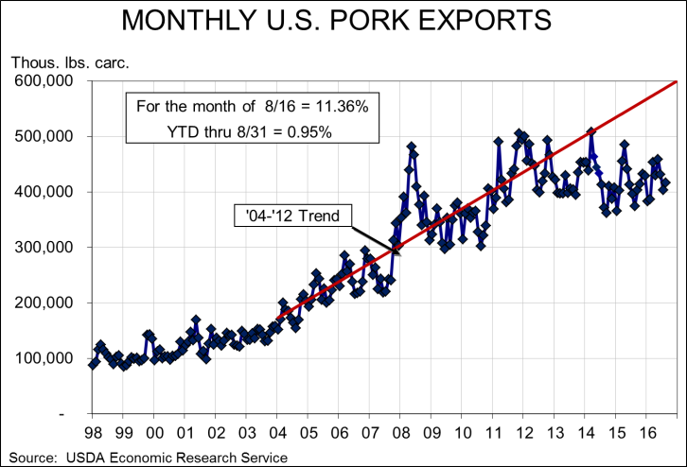
August was a very good export month +11.4% . . .
. . . YTD is FINALLY positive but note the trend

Slide 10
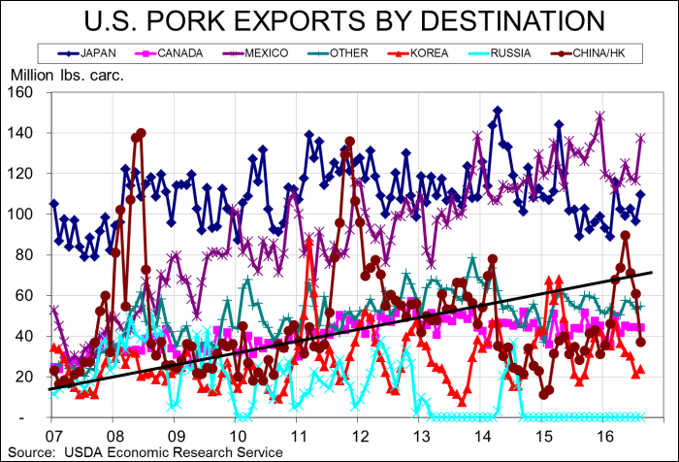
China/HK was still +31% but back to earth . . .
. . . Japan was +23%, Mexico +5%, S. Korea +37%
Mex -6%, Jap -4%, chk+135

Slide 11
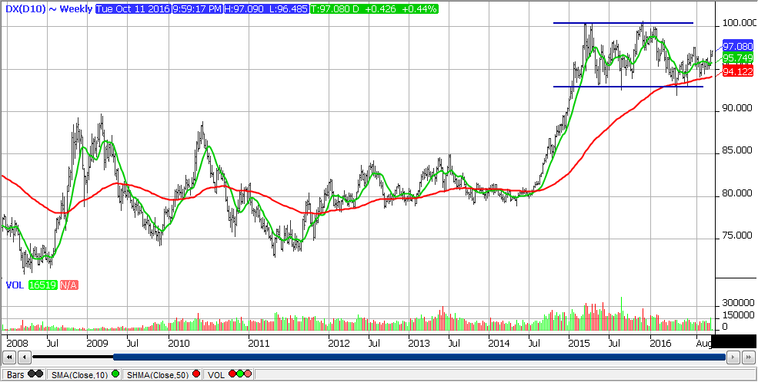
The U.S. dollar remains strong . . .
. . . And there is nothing apparent to change it

Slide 12
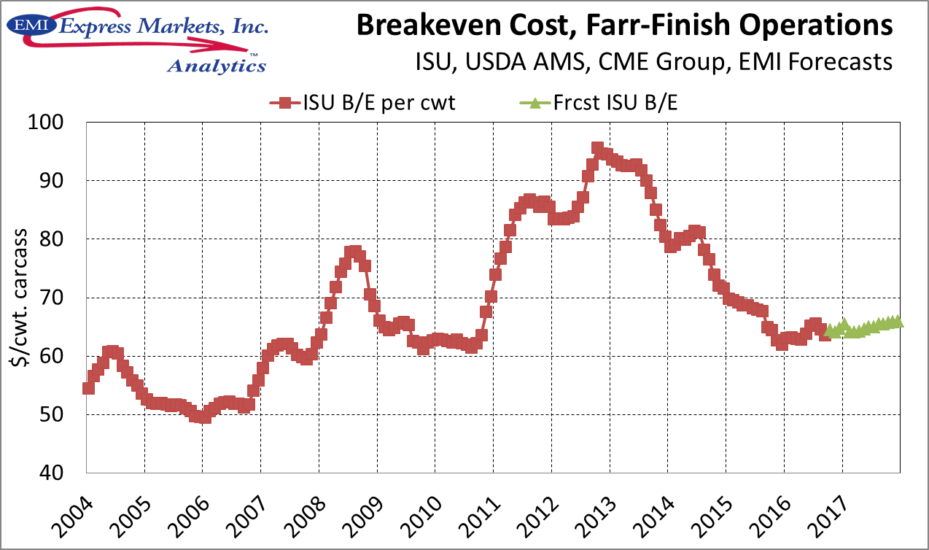
2017 costs near $64 – lowest since 2010 . . .
. . . And we think mid-$60s will be the new norm

Slide 13
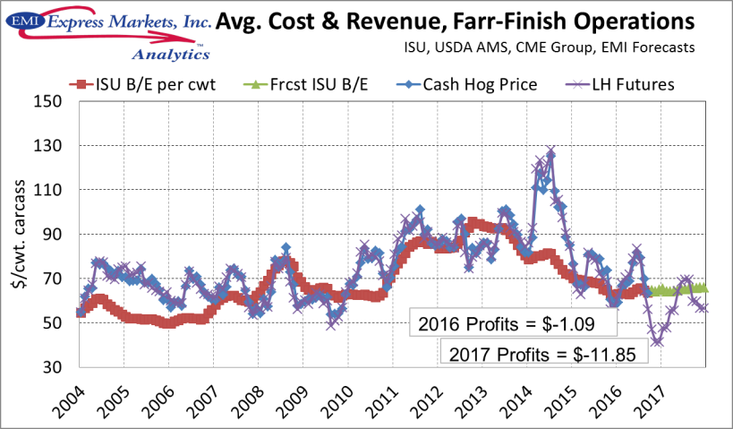
But profit outlooks have turned abysmal . . .

Slide 14
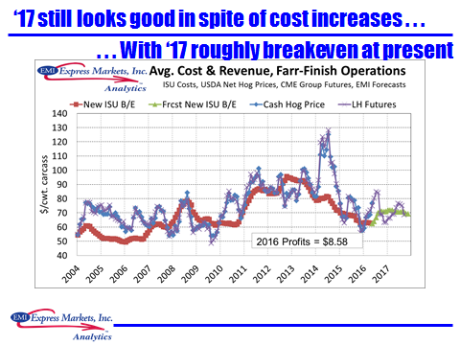
At WPX 2016 futures-based profit was $8.58

Slide 15
Underlying our pork outlook -- thoughts on beef . . .
Significant growth in beef output -- +4 to +5% in both ’16 and ‘17
Cow herd growth is slowing and will stop in early ’17 as calf prices decline
Export growth will remove some, but not nearly all, of the added output
  Per cap cons.: Up to 54 in ’16, 57 in ’17
Beef is and will be a popular feature at retail – first time in 5 years!

Slide 16
And on poultry . . .
Modest growth in ‘17 – more birds but less increase in weights – woody breast
Lower costs have restored profitability but locating new operations is more difficult
Per cap availability/consumption will be only fractionally higher through 2017

Slide 17
Total availability up 2% in ‘16 and 1% in ‘17 . . .

Slide 18
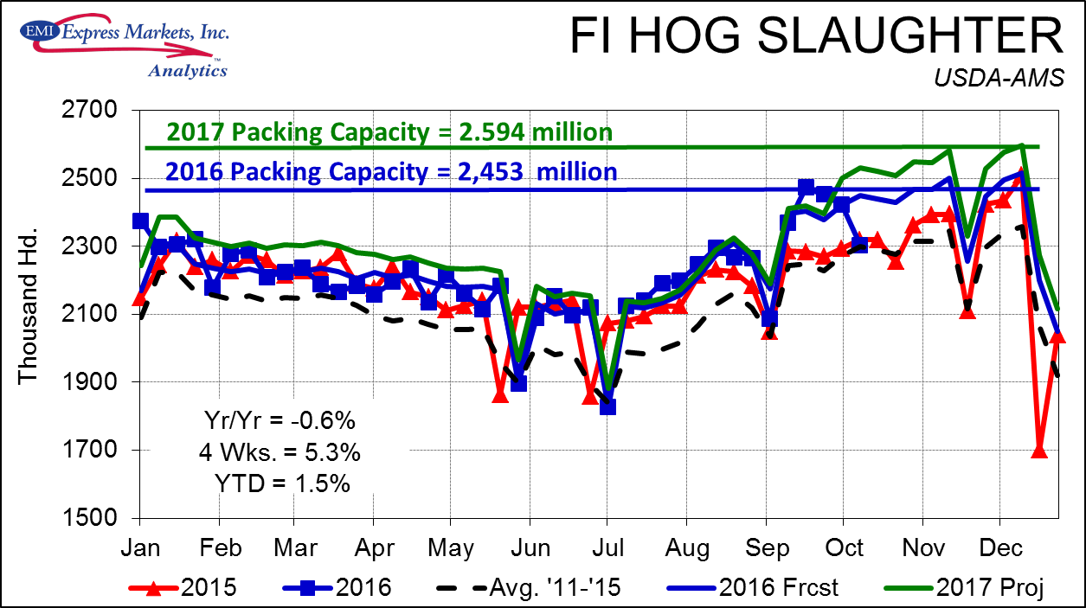
The week of 9/23 @ 2.466 million is SCARY . . .
. . . 3rd largest EVER, two lower weeks, then Matthew

Slide 19
September 30 Hogs and Pigs report . . .

Slide 20
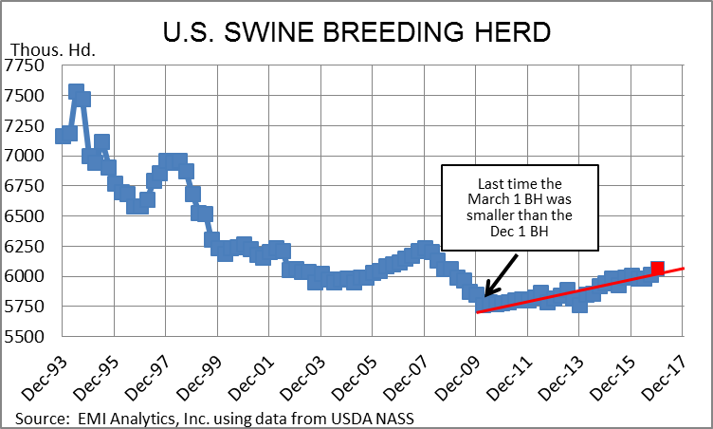
Sept 1 BH of 6.016 mil. hd. Is, we think, on track . . .
. . . At 1% yr/yr from Dec ’15; largest since 2008

Slide 21
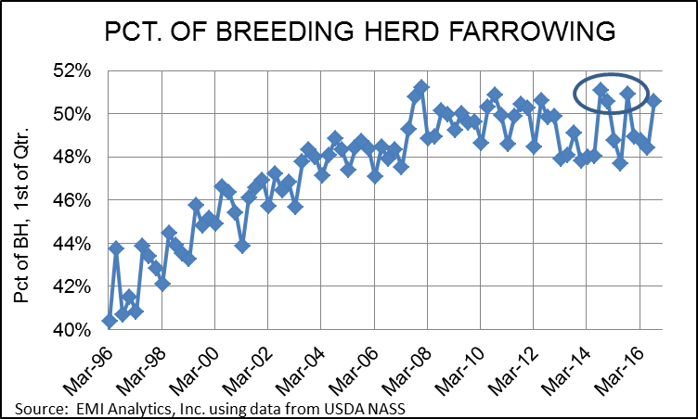
Jun-Aug farrowings: Much larger than recent. . .
. . . Which USDA has habitually revised upward

Slide 22
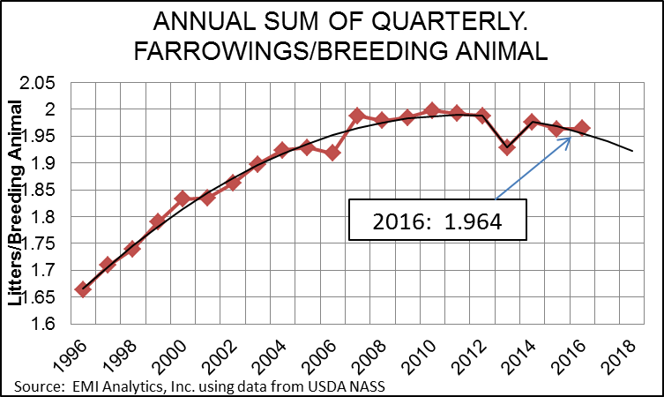
USDA revised litters nearly to our June number. . .
. . . 11.793 mil.

Slide 23
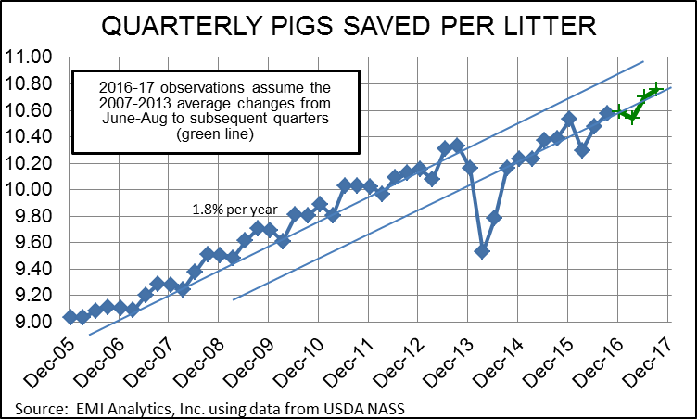
Key issue is litter size -- likely understated . . .
. . . We expect near 2% -- in 4-5 yrs will be 3%+

Slide 24
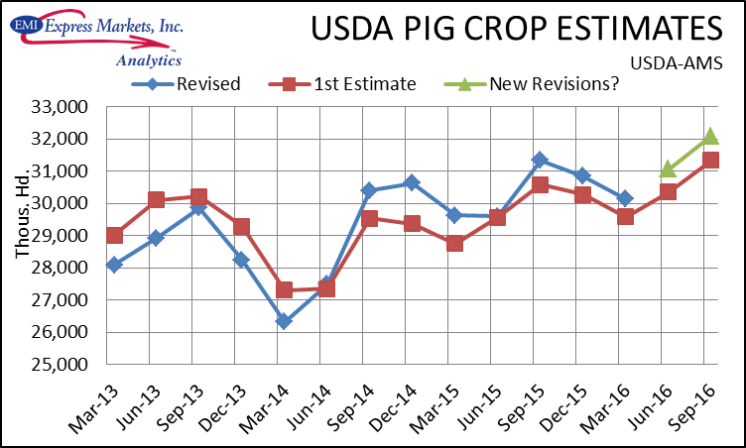
Dec-Feb pig crop revised up 1.9% -- long pattern!
. . . Average revision since Jun-Aug ‘14 is +2.4%

Slide 25
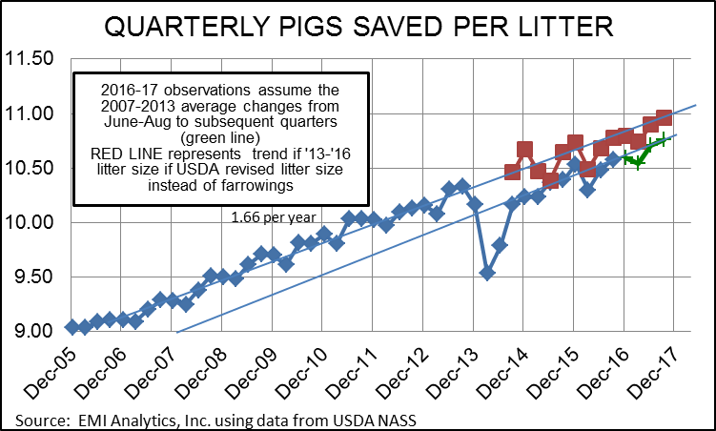
What if USDA had revised litter sizes, not farr’s . . .
. . . to account for pig crop shortfalls?

Slide 26
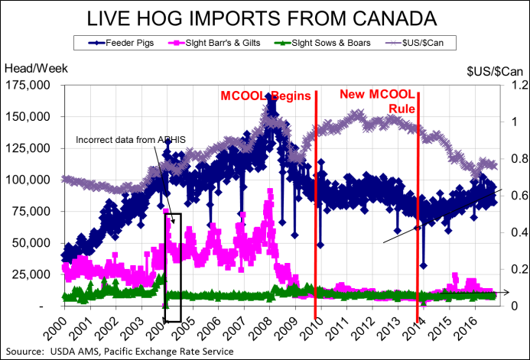
FP imports from Canada are +25k hd (8.8%) . . .
. . . MH imports are -50k hd (12%), S&B are even

Slide 27
Packing capacity update . . .
Planned increases through 2018
MoonRidge (MO) has started operations
Prime Pork (MN) has been delayed to “late Dec or early Jan” – sounds like Jan!

Slide 28
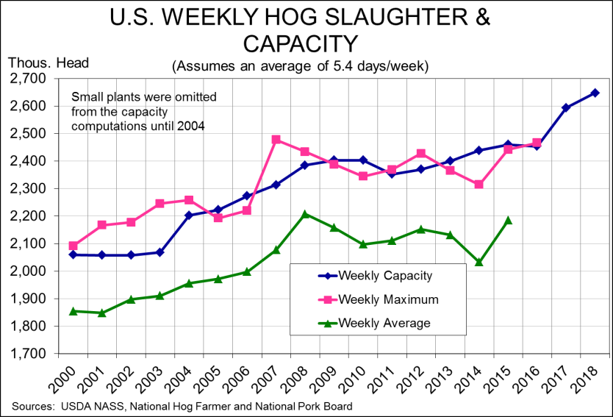
‘16 capacity is 454,320/day, 2.453 million/week

Slide 29
How does a packing constraint cause a problem?
. . . First a normal reaction to a supply increase
P
S
S’
P*
P’
D
Q*
Q’
Q/T

Slide 30
But in reality, short run supply is virtually fixed . . .
. . . And neither S or D are known with certainty
P
S
S’
P*
P’
D
Q*
Q’
Q/T

Slide 31
But what about a constraint?
Packing capacity
P
D
S
S’
Price becomes VERY HARD IF NOT IMPOSSIBLE to determine here!
P*
Q*
Q/T

Slide 32
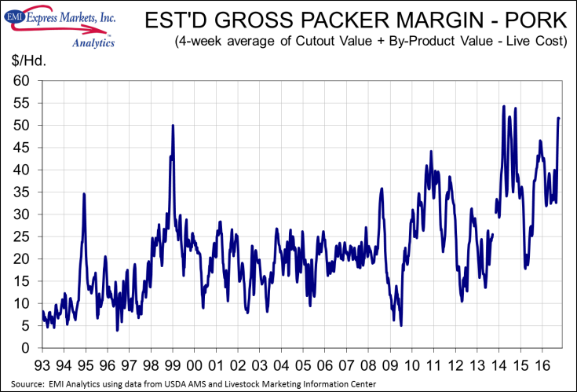
Packer margins are greater than in 1998 . . .
. . . But short of 2014 record highs

Slide 33
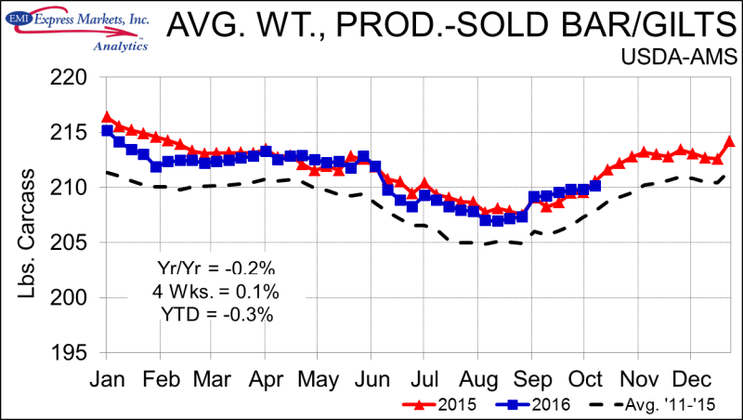
MPR data do indicate a change of mktg. pace . . .
. . . Weights “flat” since 9/1 – normal is to ^ by 1.8#

Slide 34
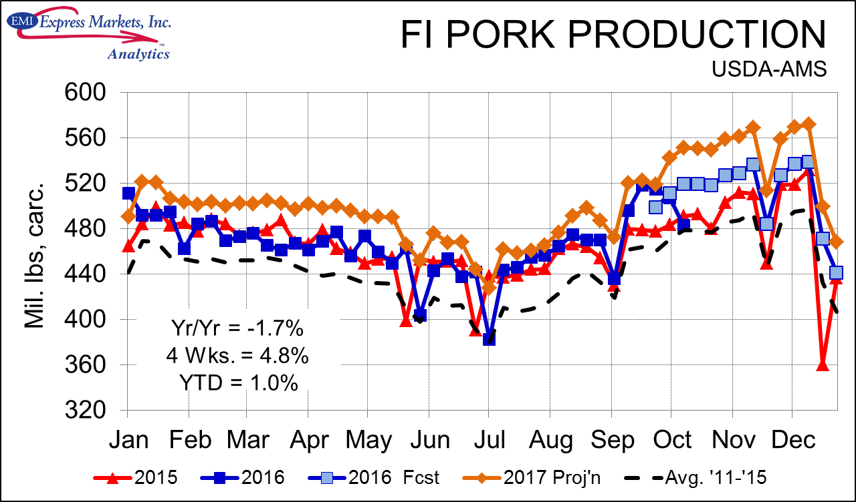
Pork production up 1.5% in ’16 and 3.5% in ‘17 . . .
. . . With Q4s up 3.1% and 4.3%, respectively, yr/yr

Slide 35
Slaughter forecasts: More BIG growth in ‘17

Slide 36
MUCH LOWER price forecasts – B/E in summer ‘17

Slide 37
Risks to the forecasts – an important practice!
Major export disruption (FMD, ASF, CSF, PT, PC) – small probability but HUGE impact
Diseases a non-factor – focus now on winter
Feed costs – ‘16-’17 is okay, next year???
Demand growth in ‘17?
  Domestic: Prefs? Wages/incomes?
  Exports: CHINA/HK, $US
Pork packing crunch in Q4?
Impact of competition for hogs in H2, 2017?
Pork prices if plants are full in ‘18?

