Slide 1
Beef Situation and Outlook National Chicken Council Annual Conference October 27, 2016

Slide 2
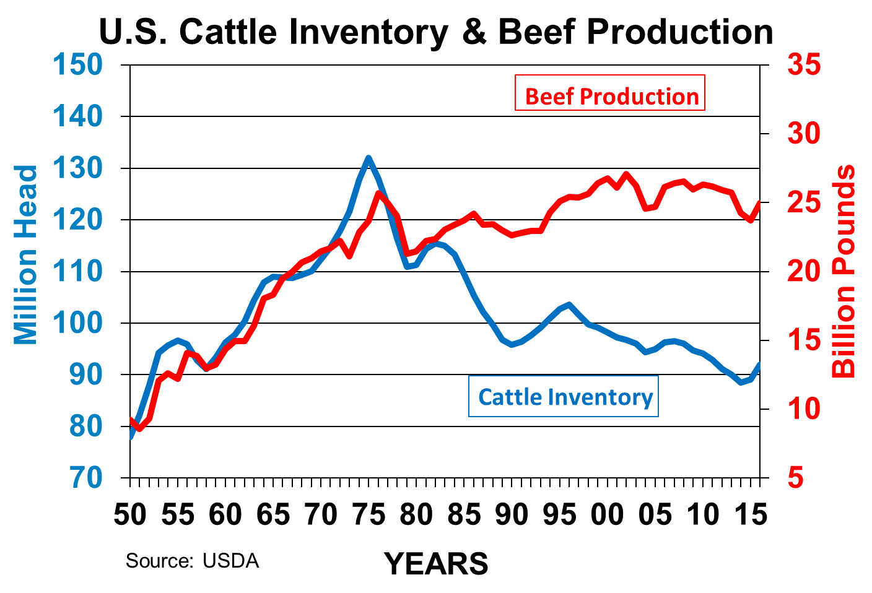

Slide 3
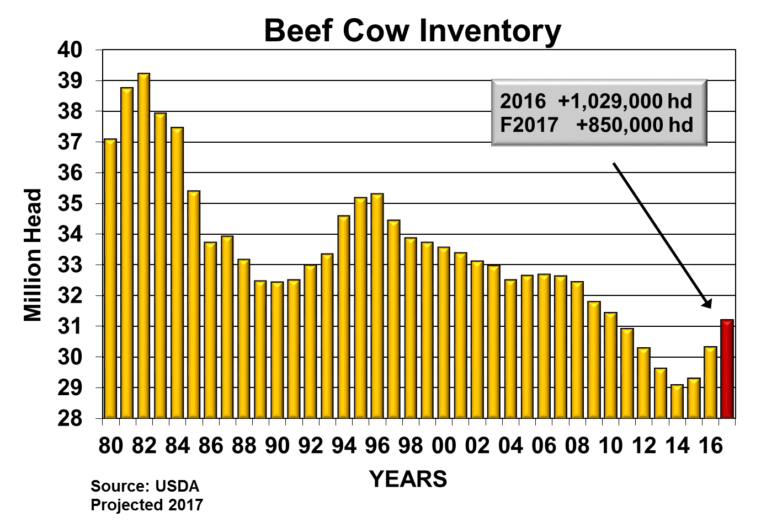

Slide 4
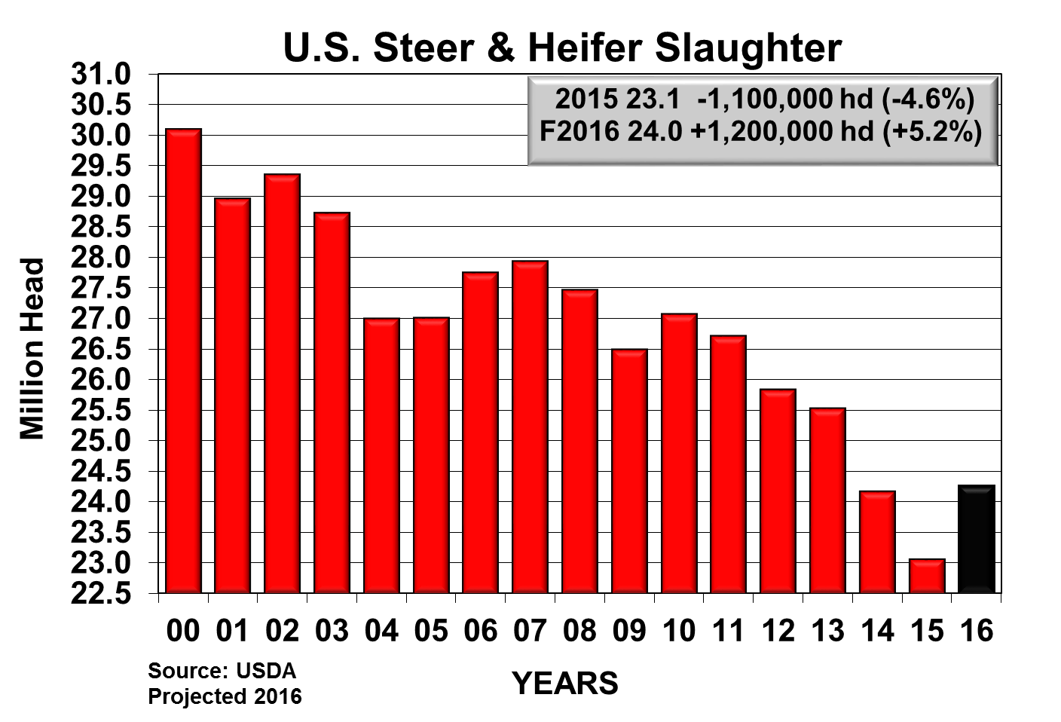
Notes:
file:///K:\RSRCH\LTO\LTO_Production%20&%20cow%20balance%20sheet.XLS
Tab – COMM str_hfr slt (3)

Slide 6
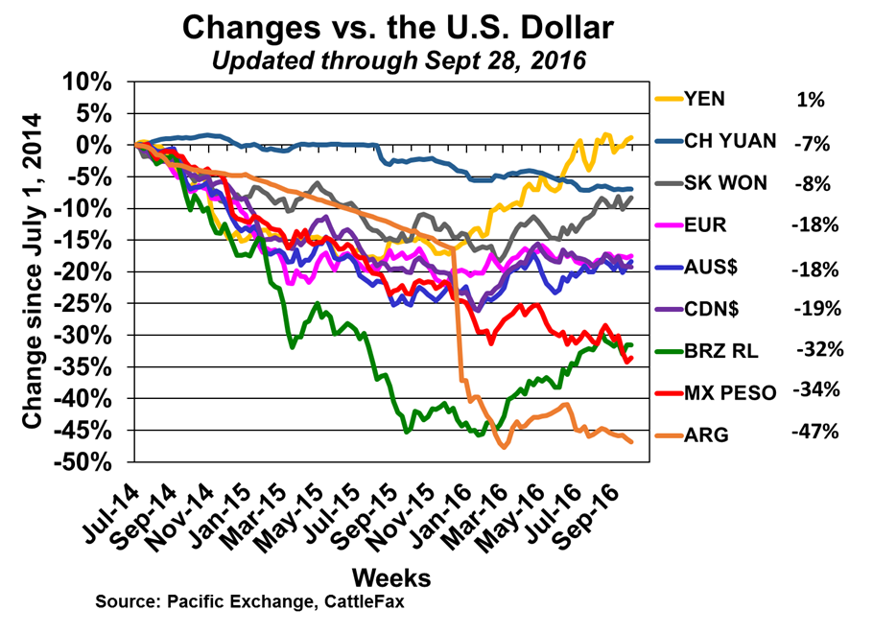
Notes:
Key meat currencies began falling to the dollar in July 2014 (beginning of this chart). This chart indexes the change in these currencies against a strengthening U.S. dollar. Note that key exchange rates stabilized this past January and many have corrected back slightly. Currency stabilization will help stabilize U.S. exports against key competitors.

Slide 7
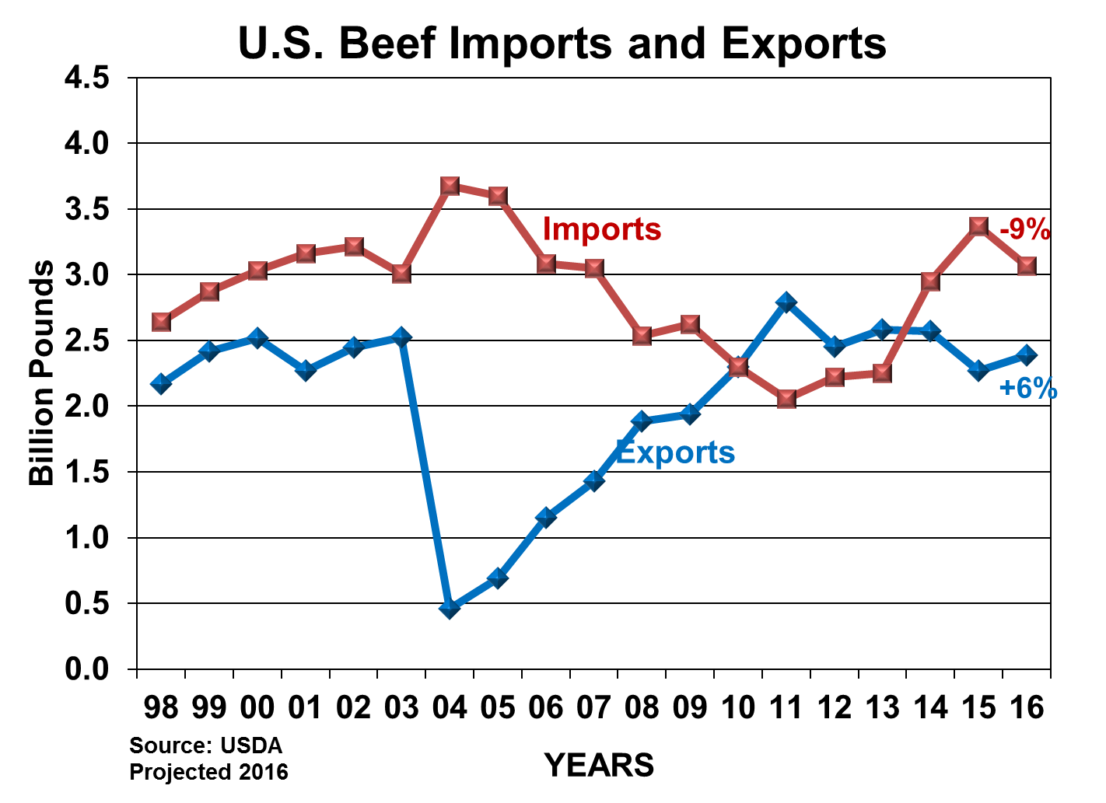

Slide 8
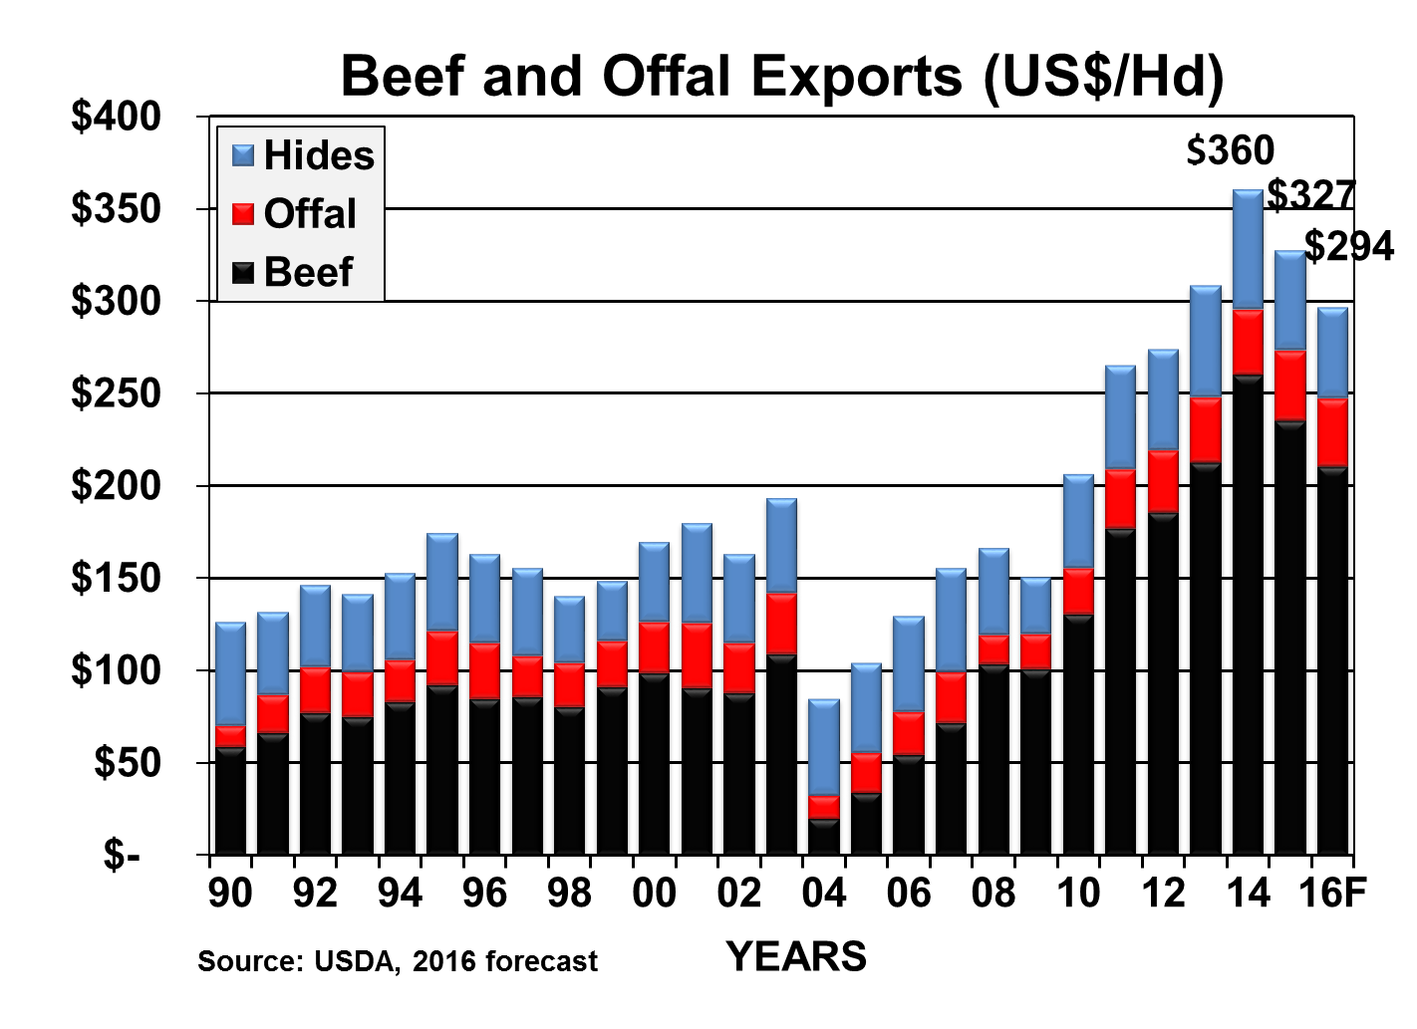
Notes:
Q:\Brett\Hold\Export pounds dollars per head 11 14.xlsx

Slide 9
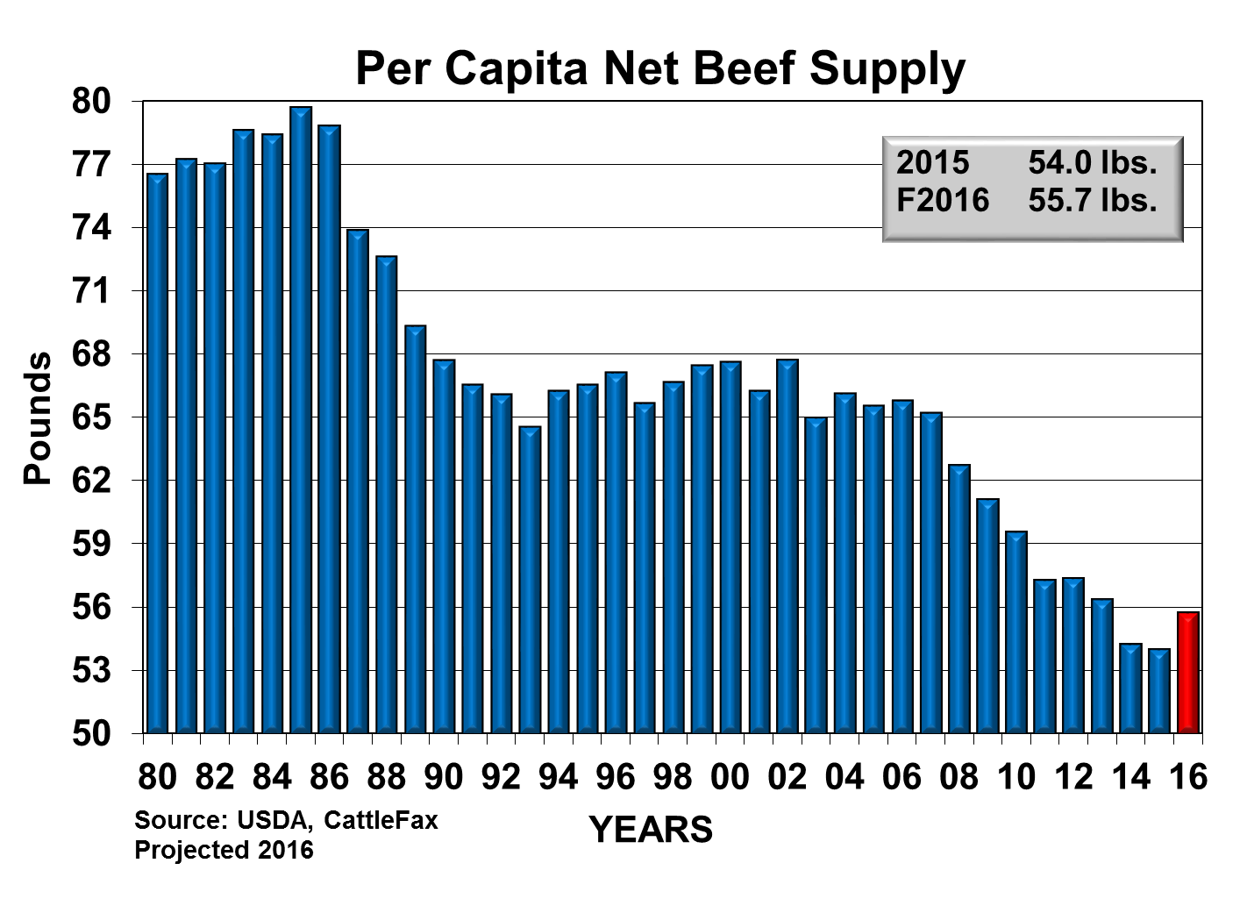
Notes:
file:///K:\RSRCH\LTO\LTO_Production%20&%20cow%20balance%20sheet.XLS
Tab – net beef 13 (3)

Slide 10
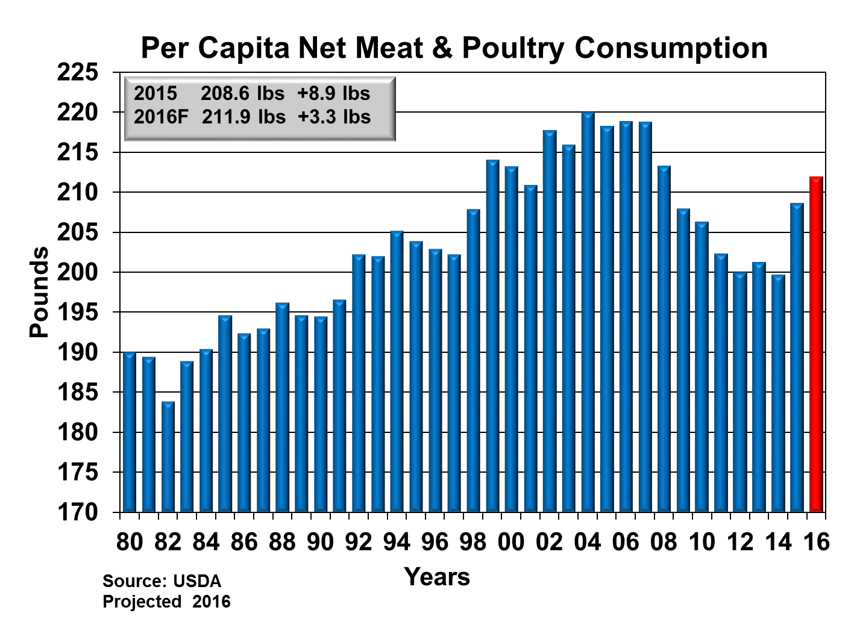
Notes:
file:///K:\RSRCH\LTO\LTO_Production%20&%20cow%20balance%20sheet.XLS
Tab – net meat (2)

Slide 11
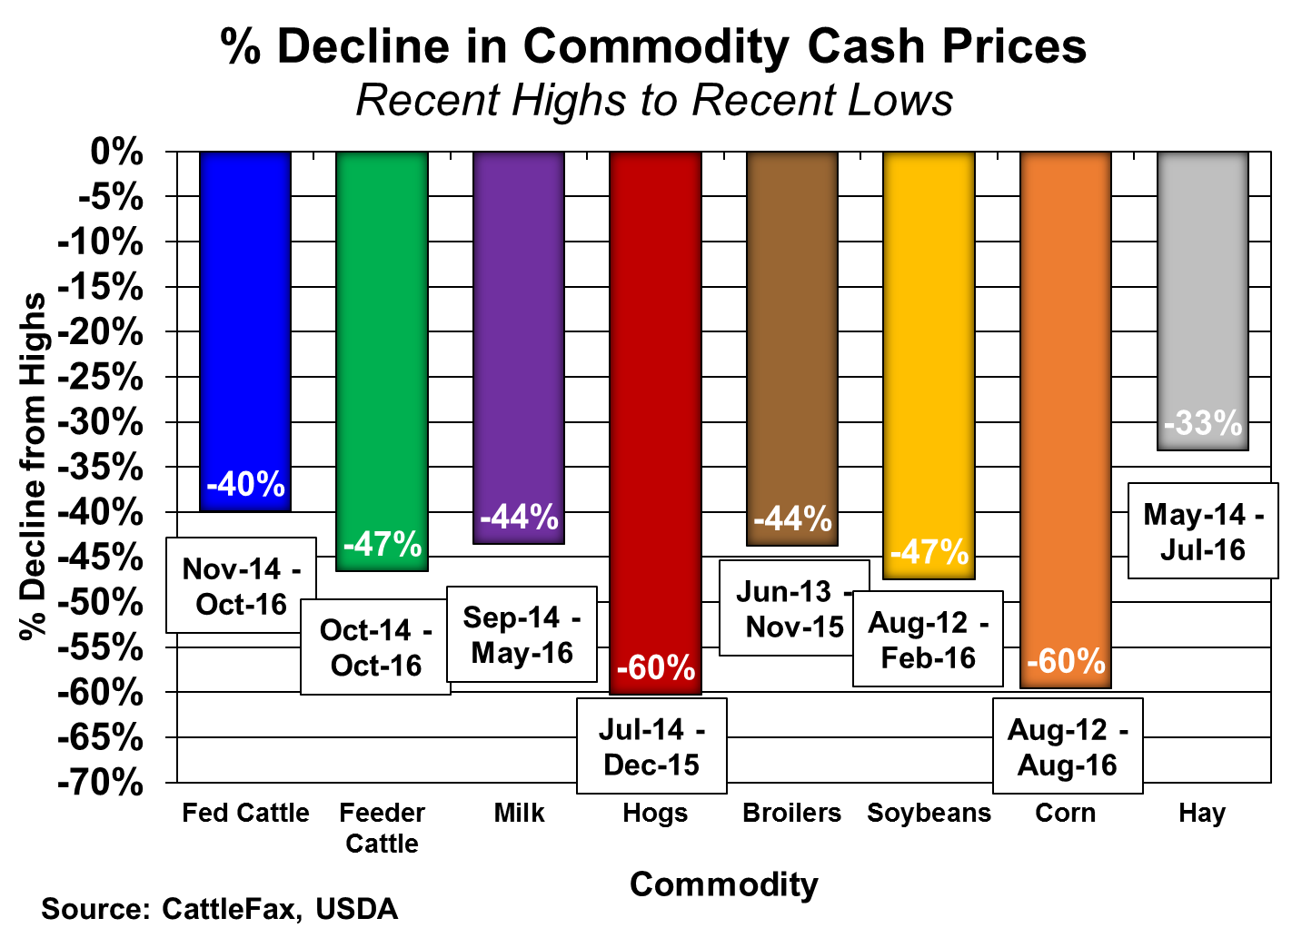

Slide 13
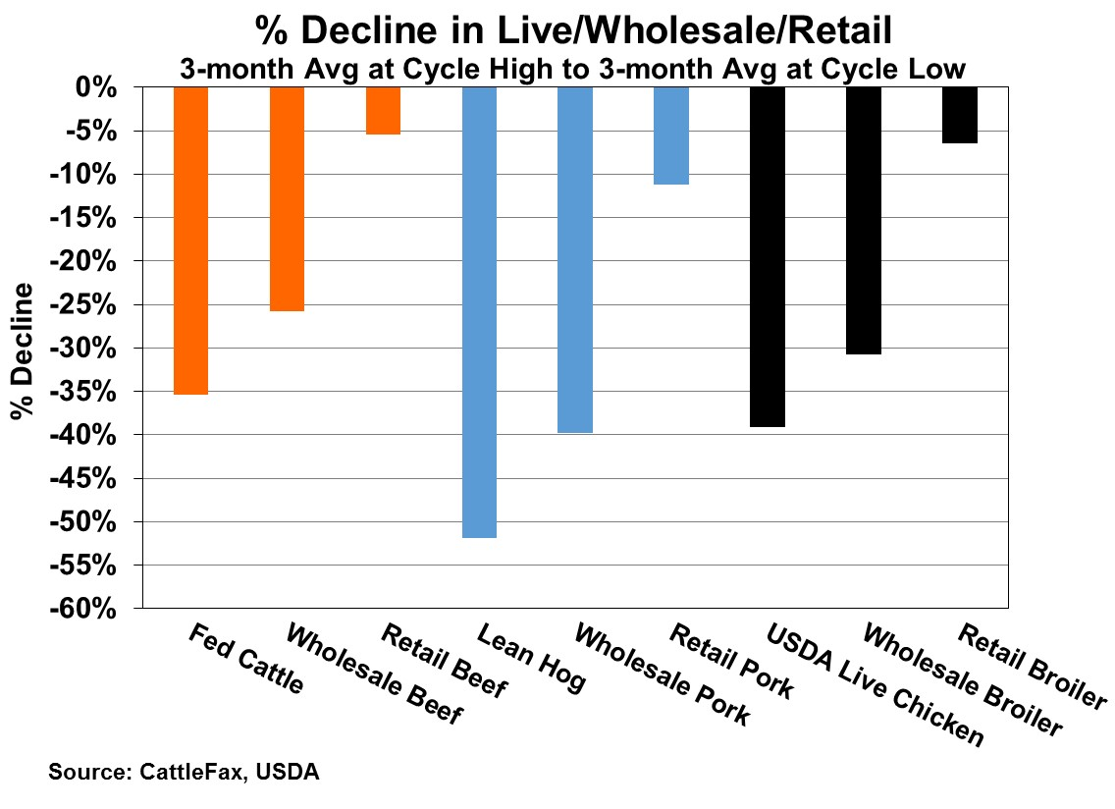

Slide 14
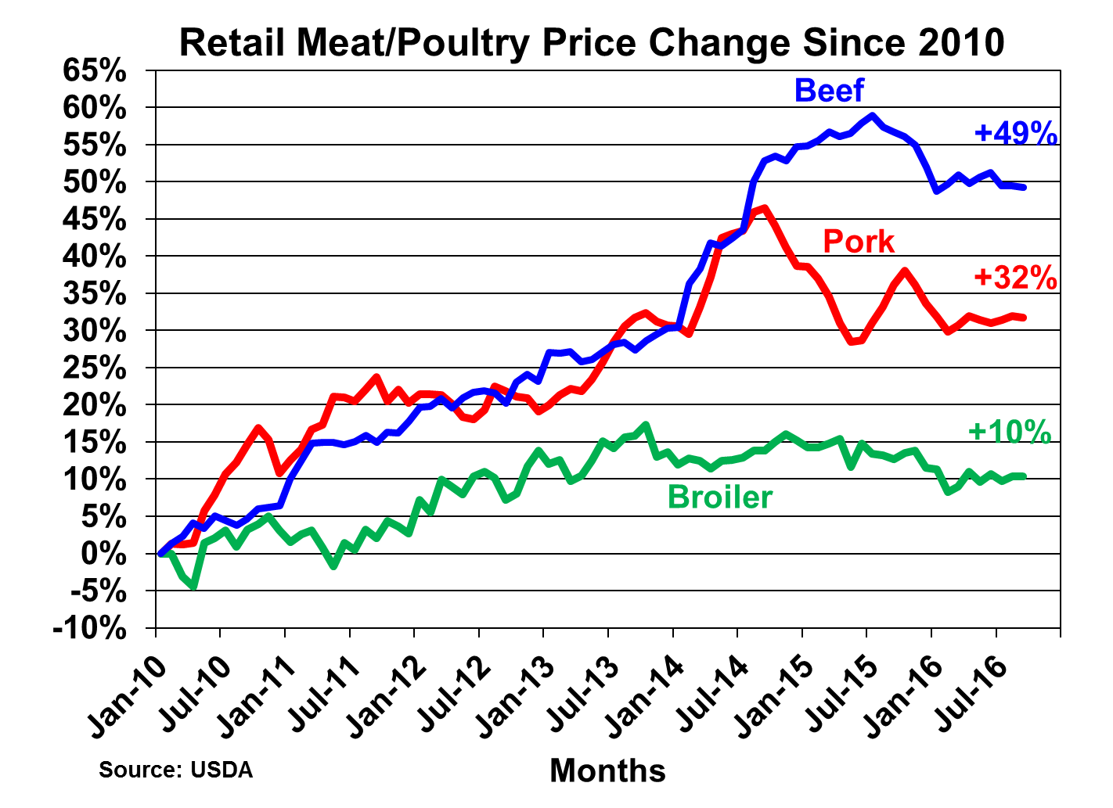

Slide 15
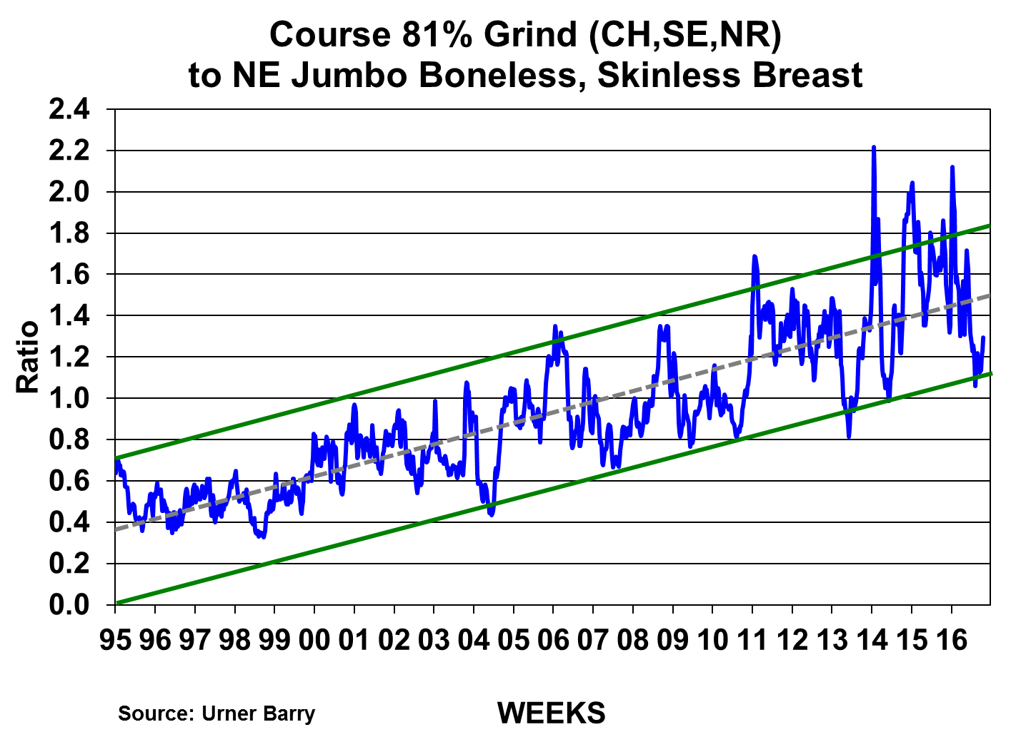
81% Grinds High Relative to Chicken Breast
81% Grinds Low Relative to Chicken Breast

Slide 16
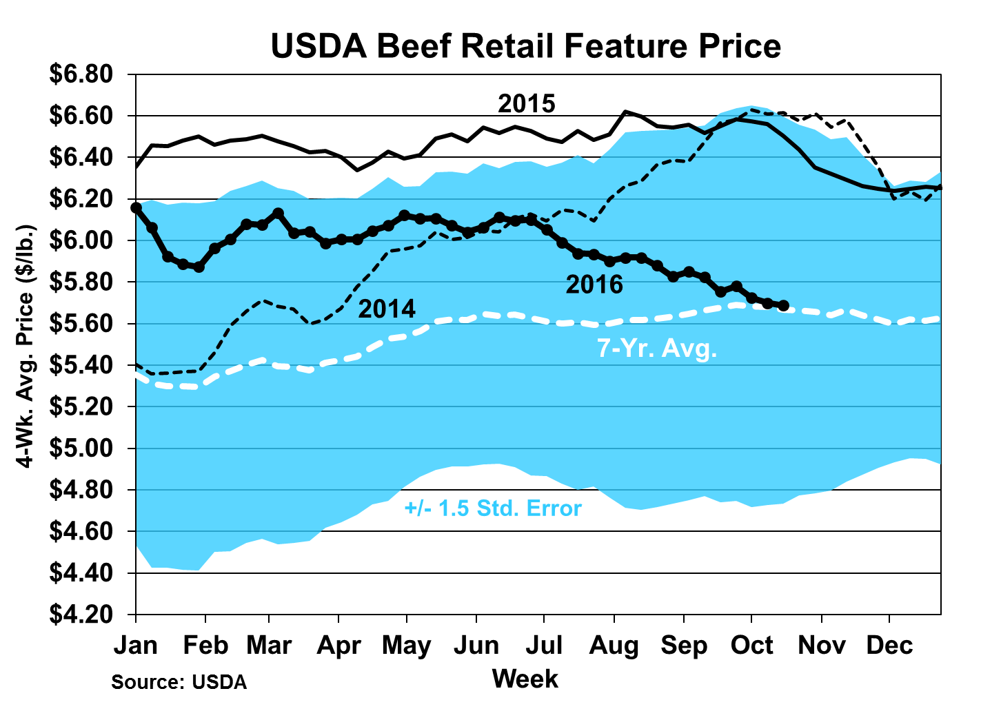
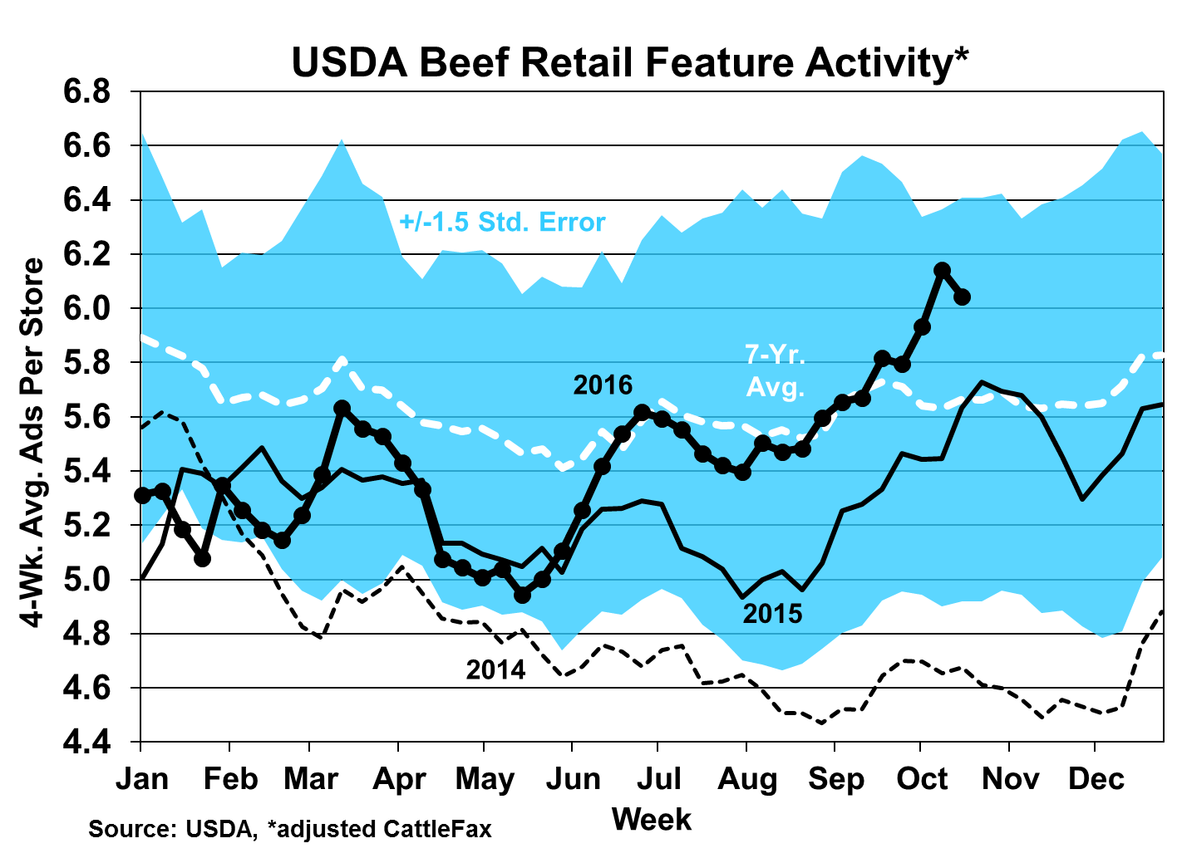

Slide 17
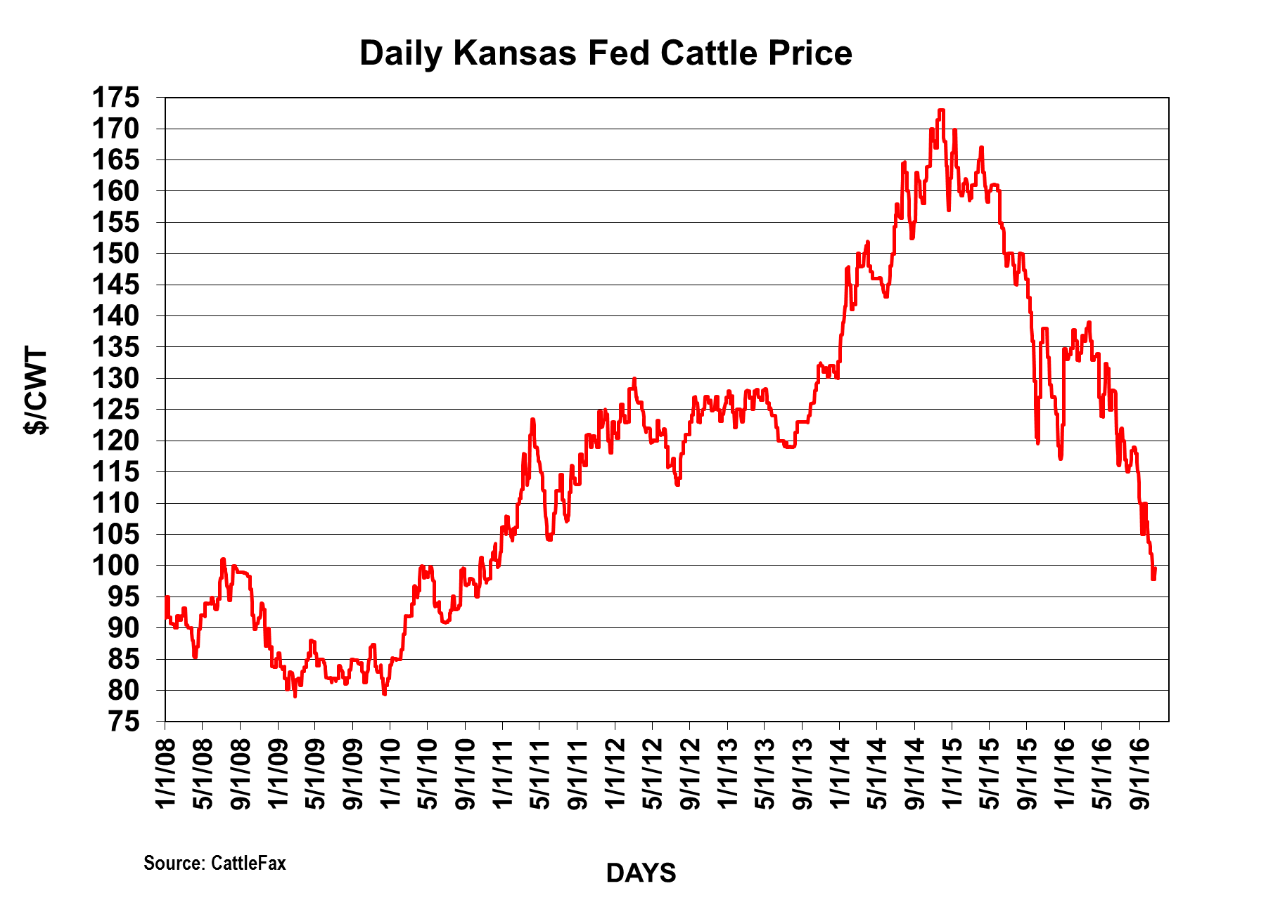

Slide 18
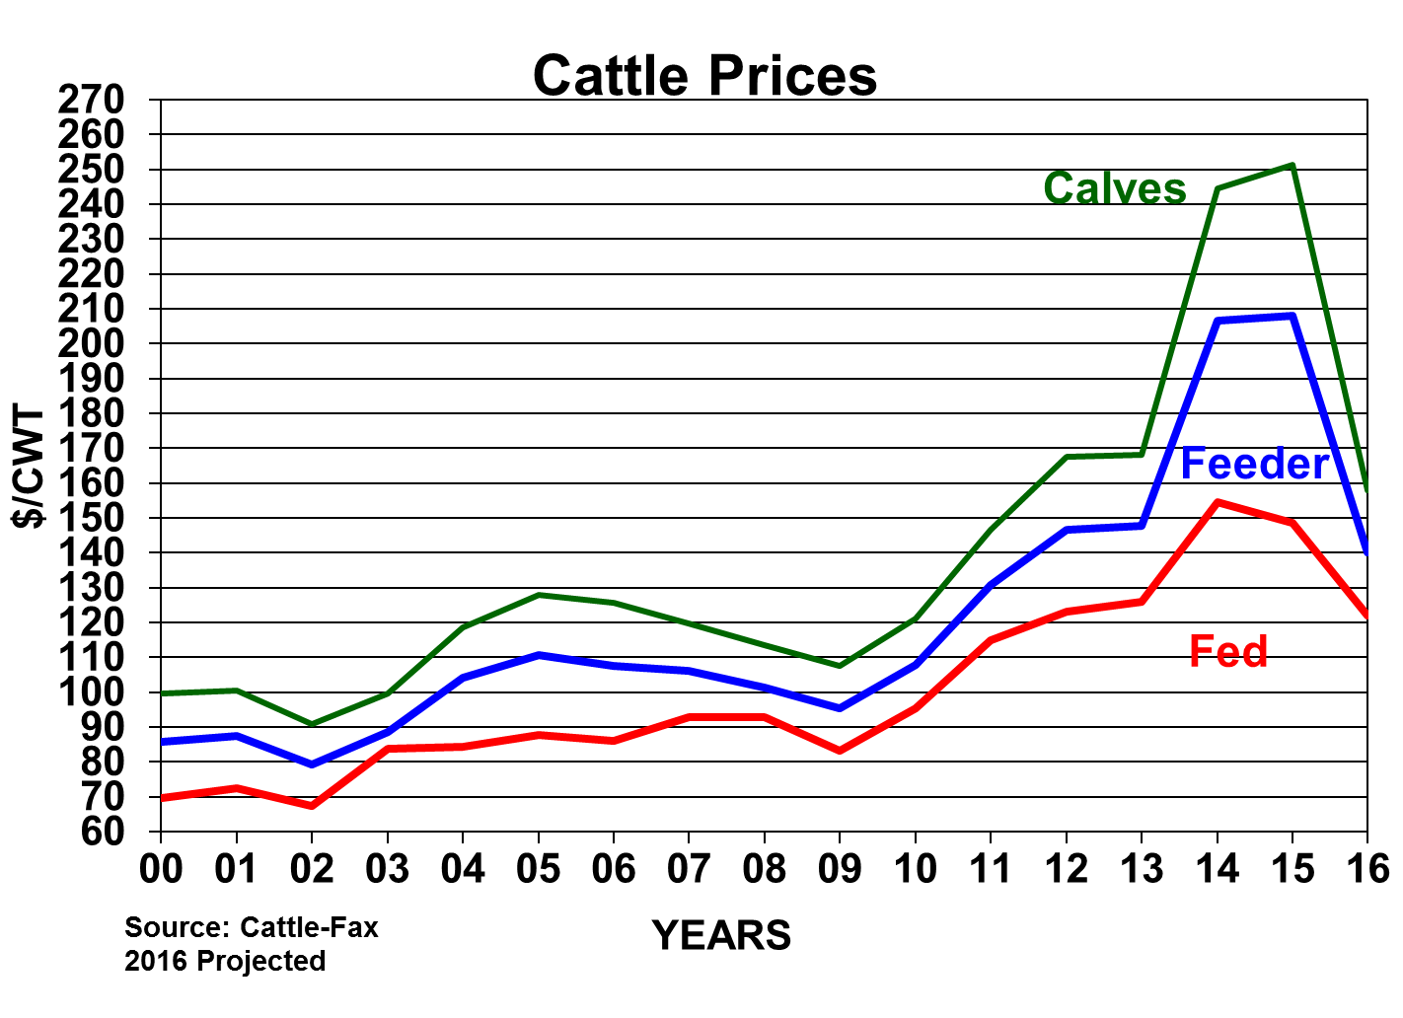

Slide 19
The Deciding
Factor

