Slide 1
Outlook for Feed Grain / Oilseed Markets
Presented to the National Chicken Council
October 27, 2016
Bill Lapp
Advanced Economic Solutions
Omaha, NE

Slide 2
Outlook presented here relies on publicly available data sources
  CME & NYMEX futures history
  USDA supply/demand data
  Census bureau trade data
  CFTC commodity reporting data
All opinions are those of Advanced Economic Solutions

Slide 3
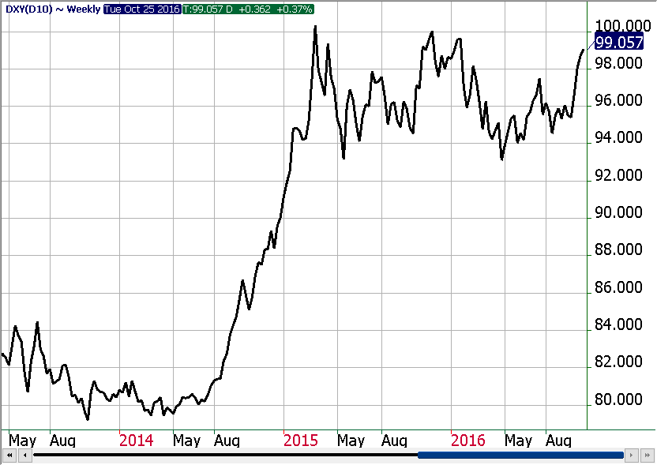
Key Market Drivers:
- Value of US dollar
Changes in the value of the US dollar influence commodity prices
  A stronger US dollar is generally negative for commodity prices
  A weaker US dollar is generally positive for commodity prices
The US dollar rose by 20% during late 2014, but has been more stable since
A sharp move in the value of the US dollar (up or down) would impact commodity prices
Source: CME, AES

Slide 4
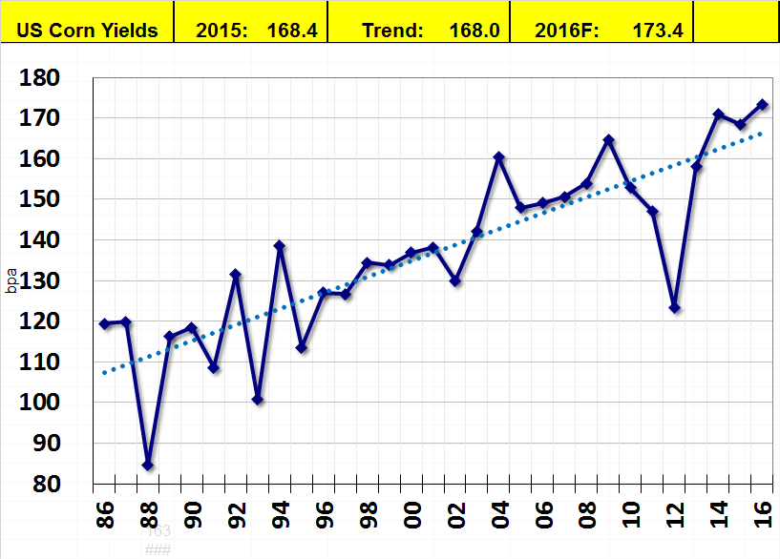
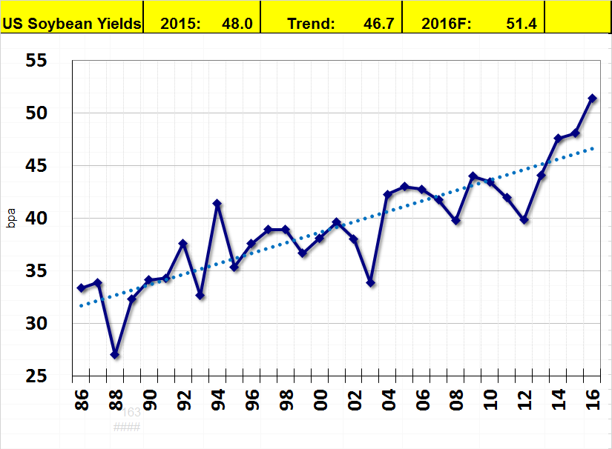
Key Market Drivers:
- Favorable growing conditions / higher yields
Source: USDA, AES

Slide 5
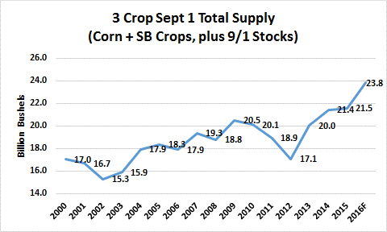
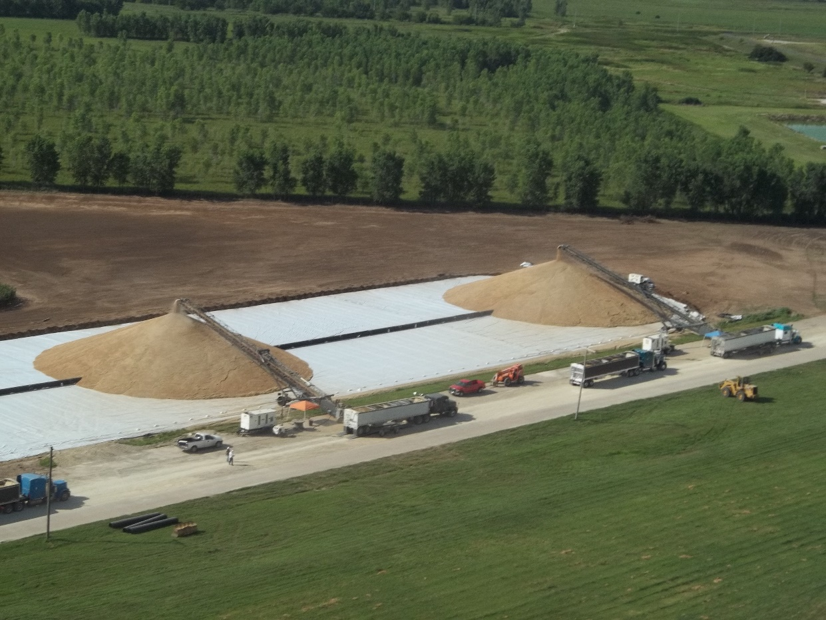
Key Market Drivers:
- Record Sept 1 Supplies of Corn/Soybeans/Wheat
Source: USDA, AES

Slide 6
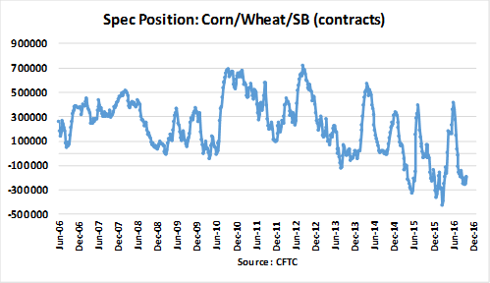
Key Market Drivers:
- Speculator (“Managed Money”) Participation
Source: CFTC, AES

Slide 7
Key Market Drivers:
- USDA Upcoming Crop Reports
Weekly harvest updates (each Monday)
Nov 9: USDA update of corn/soybean crop estimate (and supply/demand estimates)
Dec 12: USDA update of supply/demand estimates
Jan 12: USDA final corn/soybean crop estimates, December 1 stocks report, 2017 winter wheat seedings, and update of supply/demand
Source: USDA, AES

Slide 8
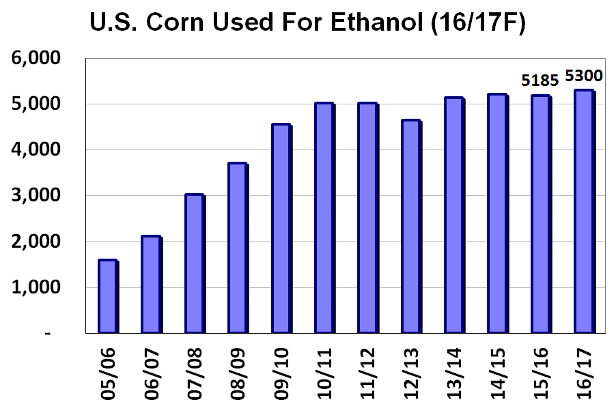
Key Market Drivers:
- Slowing growth in ethanol usage of corn
After years of rapid growth (2005-10), corn use for ethanol has stabilized at 5.2-5.3 B bushels
Ethanol use is limited in the U.S. by the 10% “blend-wall”
Source: USDA, AES

Slide 9
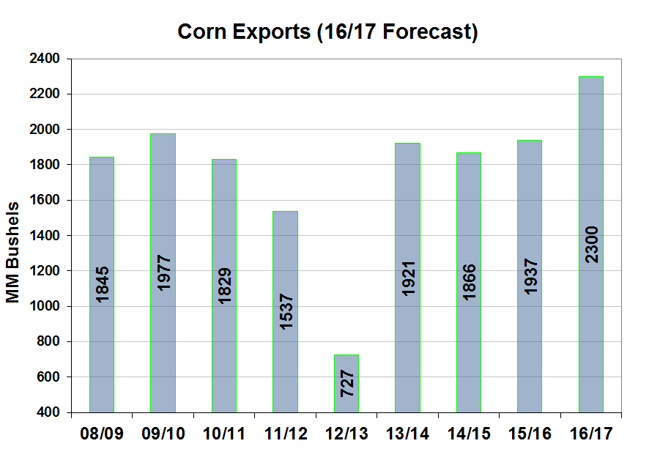
Key Market Drivers:
- Corn exports rising to 9 year high
US regaining exports due to shortfall in Brazil’s corn crop
Strong weekly demand is helping support corn futures
Source: USDA, AES

Slide 10
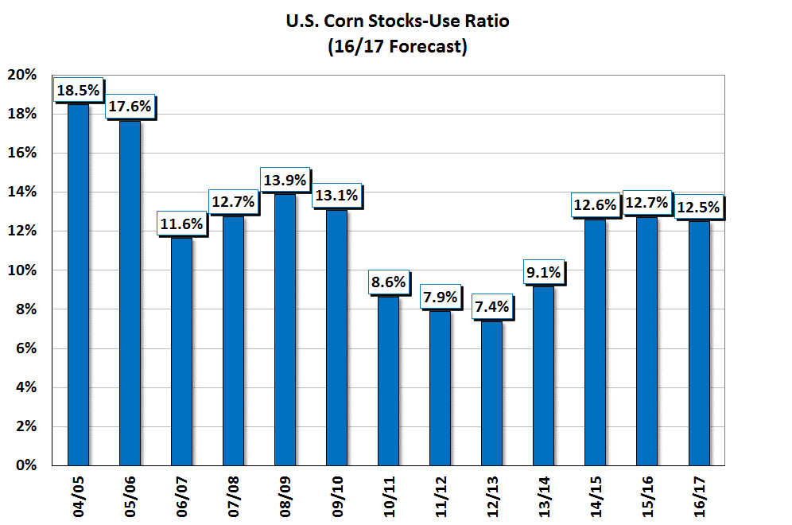
Key Market Drivers:
- Corn Stocks-Use to Remain near 12-13%
Historically, lower stocks-use ratio has been supportive to prices
  2010/11 – 2013/14
Higher stocks-use ratio has led to lower corn prices
  2014/15 – 2016/17F
Source: USDA, AES

Slide 11
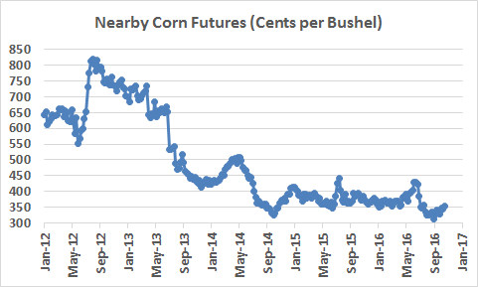
Corn Futures Prices: 2012-Present
Corn prices in recent months have declined to multi-year lows, reflecting record US corn yields
Price direction in coming months is expected to be driven by:
  USDA crop estimates in November & January
  Export demand and ethanol usage rates
  Changes in “Spec” positions
  Development of South American corn crops
Source: CME, AES

Slide 12
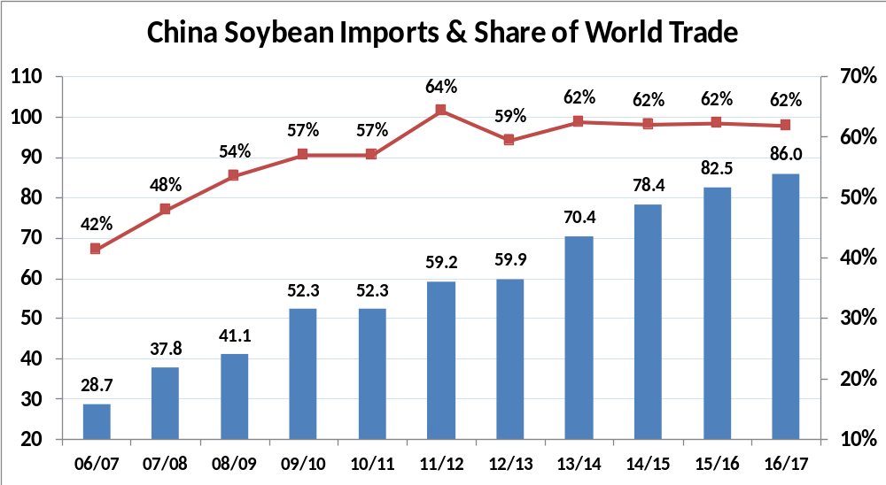
Key Market Drivers:
- China Dominates World Soybean Trade
Source: USDA, AES

Slide 13
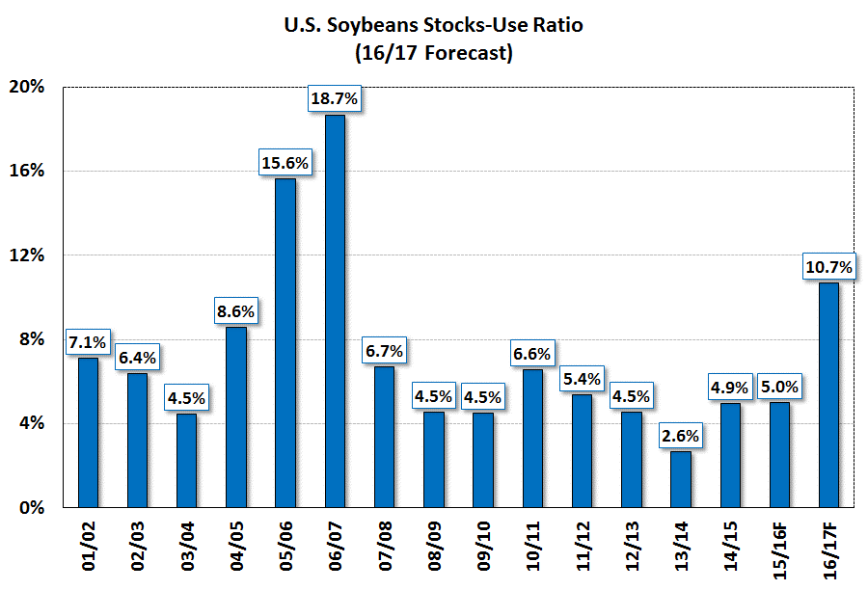
Key Market Drivers:
- Soybean Stocks-Use Rising to 10-year High
Record US soybean crop has led to lower US soybean and soymeal prices
Risks to 16/17 forecast:
  Revisions to US crop size
  S. American crop size
  Fund buying/selling
  China
Source: USDA, AES

Slide 14
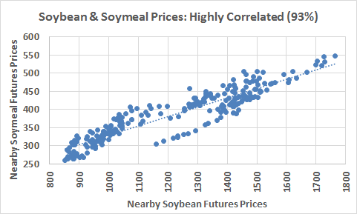
Key Market Drivers:
- Soybean price dictate direction of soymeal prices
Source: CME, AES

Slide 15
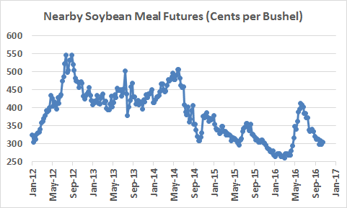
Soymeal Futures Prices: 2012-Present
Soymeal prices have remained above $300, in spite of a record 2016 US soybean crop
Price direction in coming months is expected to be driven by:
  USDA crop estimates in November & January
  Changes in “Spec” positions
  Development of South American soybean crops
  Chinese import demand
  Soyoil price strength
Source: CME, AES

Slide 16
Outlook for Feed Grain / Oilseed Markets
Presented to the National Chicken Council
October 27, 2016
Bill Lapp
Advanced Economic Solutions
Omaha, NE

